Slide 1

NI
LECTURE
Windows 2016:
Resource Management
(Managing Resource Access)
Networking Infrastructure
Diploma in CSF/IT
Year 2 (2020/21), Semester 3
15
Notes:
1

Slide 2
Objectives
At the end of this, you will be able to understand the following:
File System Security (NTFS Permissions).
Securing resources (e.g. folders, files) with NTFS permissions.
Effective Permissions.
Creating and Managing Shared Folders.
Understanding Share Permissions.
Creating and Managing Printers. [Optional]

Slide 3
Managing File System Security
Administrator’s Job:
Secure resources and allow only authorized users to access them.
Resources include file, folders, printers.
File System Security requires NTFS partition.
FAT and FAT32 provides no security.
NTFS offers compression, encryption and security.
Notes:
3
NTFS covered in OSF Module.

Slide 4
NTFS Permissions
Understanding NTFS Permissions
Affect files/folders on NTFS formatted partitions.
Set on both folders and individual files.
Affect both local and remote users.
NTFS permissions set on a folder are inherited by default, but that can be changed – block inheritance.
Can be assigned by an owner, a user with Full Control or Modify Permissions.
NTFS permissions are specified in the object’s ACL (Access Control List) and are used to control access to the object e.g. folder, file.
Notes:
4

Slide 5
NTFS Standard Permissions
Permission | Description
Full Control | Modify permission, delete subfolders and their files, change permissions, take ownership.
Modify | Read & Execute permission, Write permission, create and delete file and folder.
Read & Execute | Can read file content, execute file. Can list folder content, view folder attributes and permissions, traverse folder.
Read | Can read file content, list folder content.
Write | Can create file, write data to file, create folders.
List Folder Contents (folders only) | Can list folder content, view folder attributes and permissions, traverse folder.
Reference: https://technet.microsoft.com/en-us/library/cc732880.aspx
Notes:
5

Slide 6
NTFS Permissions Inheritance
Default Windows 2016 behaviour:
Permissions assigned at a higher-level folder propagate to child files and folders.
By default files and folder will inherit permissions from their parent objects.
Notes:
6
If security permissions were inherited from a higher level you can see boxes grayed out and cannot be changed.

Slide 7
NTFS Permissions Inheritance
Two main types of permissions apply to objects:
Explicit Permissions:
Access control rules that are directly applied to an object.
Implicit Permissions:
Access rules defined for parent objects and propagated down to the object itself
Explicit Permissions automatically override implicit permissions.
An explicit allow permission will override an implicit deny.
Notes:
7

Slide 8
Effective Permissions
User and Group NTFS permissions are cumulative or additive (combine for the least restrictive combination), except where Deny overrides Allow.
File permissions are separate from folder permissions
When a user belongs to multiple groups, the least restrictive permission wins, except when specifically Denied. Then any Deny overrides Allow.
Example:
If James is a member of both the Sales and Marketing groups, he will have all of the permissions that are allowed for both groups (cumulative).
Notes:
8

Slide 9
Effective Permissions
What is James’ effective permissions?
Read and List Folder Contents.
Prohibited from writing to Public folder.
Notes:
9

Slide 10
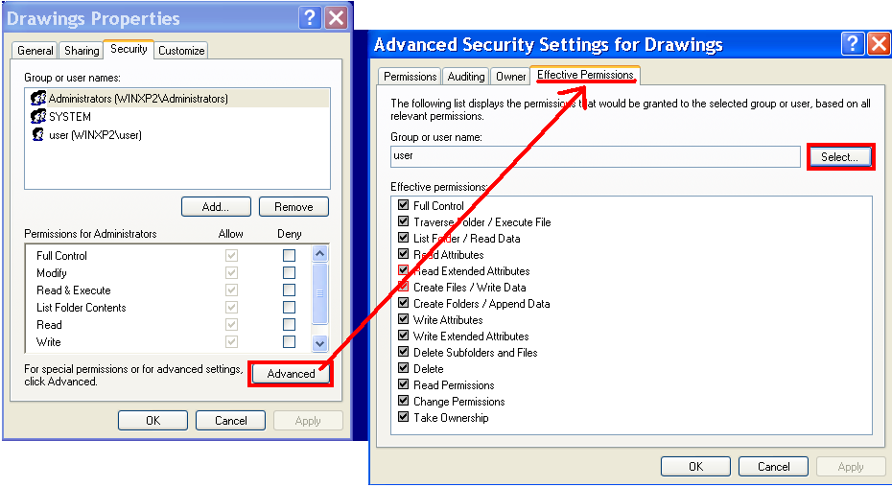
Effective Permissions Tool
To calculate and view effective permissions for a user or group.
Click Advanced button in Security tab of a folder’s properties
Does not take into account share permissions.
Notes:
10

Slide 11
Understanding Ownership
Problems:
Accidentally deny access to Everyone Group.
Delete the only user account that had permissions on a file.
Ownership resolves these issues
Every Windows object (file/folder) has an owner.
By default, creator of an object is its owner.
Click Advanced on Security tab for the properties of file or folder. Under Owner tab.
Ownership doesn’t change by users simply editing a file
Notes:
11

Slide 12
Understanding Ownership
An owner has Full Control permission for a file/folder and can grant other users NTFS permission to that file and folder
Other users regardless of their permissions cannot lock that user out from accessing the file as long as the user remains the owner of the file.
Members of the Administrators group can take ownership of a file or folder and replace permissions.
Useful when file is not accessible when the user account has been deleted.
An object owner (or anyone with “Full Control” permission) can grant “Take Ownership” permissions to another user or group in order to allow others to take ownership of files or folders and change permissions.
Notes:
12

Slide 13
Best Practices for Managing NTFS Permissions
Grant permissions to groups as opposed to users
Assign sales users to “SALES” groups and then assign permissions to SALES group.
Easily add to, or remove members of group without making security setting changes.
Use understandable names for resources
Better to name a folder “Marketing” than “mktg”, “mrktg”
Create a logical hierarchy of folders based on your business requirements.
Create a top level folder called Departments and create separate folders for each department (Marketing, Sales).
Notes:
13

Slide 14
Best Practices for Managing NTFS Permissions
Grant users only the permissions that they require.
Balance between security and usability
Give minimum permissions to perform jobs.
Grant Read & Execute permission for application folders
Grant Read & Execute and Write permissions for data folders
Review permissions settings regularly.
Notes:
14

Slide 15
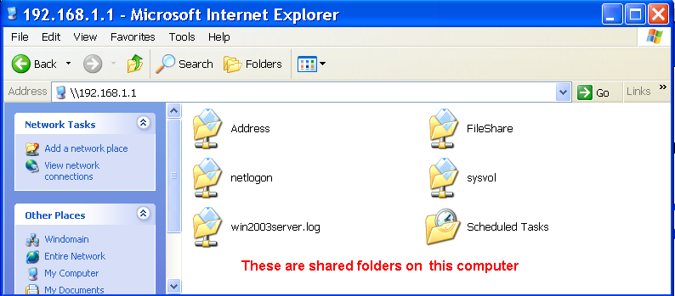
Shared Folders
Called “shares” .
Sharing is used to provide access to a file/folder on one computer to another computer over the network.
Typical network has:
Public folders (all users can exchange files and info)
Specific shared folders (accessible to only members)
Notes:
15
In this example, the shared folders are on the Windows Server (IP address: 192.168.1.1) and can be accessed using \\192.168.1.1

Slide 16
Shared Folders
File system folders can be made available over the network through multiple share names.
Share name can be different from folder’s names.
Entire volumes can be shared.
Notes:
16

Slide 17
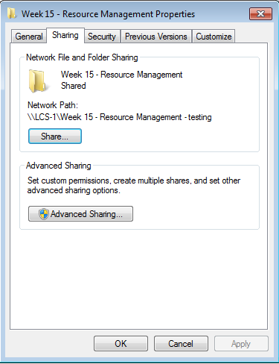
Creating Shared Folders
Right click on folder, choose Sharing tab.
Click Advanced Sharing.
Tick “ Share this folder”.
Specify :
Share Name.
Optional descriptive comment.
Number of simultaneous users for the share.
Set Permissions. (See slide 20)
Notes:
17

Slide 18
Hidden Shared Folders
Place $ sign after share name (i.e. hiddenshare$)
Accessible but not shown when users are browsing for resources.
Access a hidden shared folder by typing the UNC path, for example, \\server\hiddenshare$
Notes:
18

Slide 19
Share Permissions
Shared folders have security permissions that control what permissions users have on the folder and its contents.
Apply only to users accessing resource over the network, NOT to local users. When accessing a file locally, only NTFS permissions apply
All files and subfolders within a shared folder are shared with the same permissions.
Share permissions apply to entire folders, not to specific files.
Only way to secure files on FAT volume.
Shared folder status is discarded when a folder is moved.
Notes:
19
Share permissions are often used for managing computers with FAT32 file systems, or other computers that do not use the NTFS file system.

Slide 20
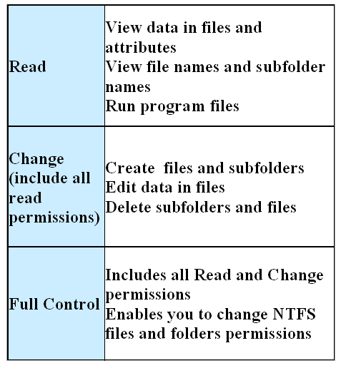
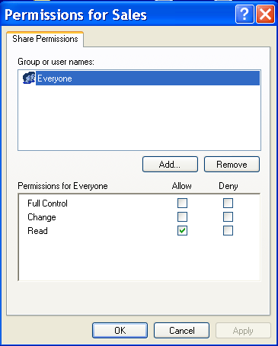
Share Permissions
Default: Everyone built-in group has read permission
Notes:
20
“Read” similar to NTFS’s “Read and Execute” in
“Change” similar to NTFS’s “Modify”

Slide 21
Combining Share and NTFS Permissions
When combining share and NTFS permissions always choose the MOST restrictive combination
Most Administrators, Server Operators and Power Users are given full control access on shares and place appropriate permissions using NTFS permissions.
Example:
James has Read share permission
James has “Modify” NTFS permission at file system level
Effective Permissions: Only able to read the file
Notes:
21

Slide 22
Combining Share and NTFS permissions
Step 1: Determine effective NTFS permissions by cumulating (least restrictive) all permissions. The exception is Denied permission overrides Allow.
Step 2: Determine effective Share permissions by cumulating all permissions. The exception is Denied permission overrides Allow.
Step 3: Final effective permissions are determined by combining the results of NTFS and Share, choosing the MOST restrictive permissions.
Notes:
The final access permissions on a shared folder are determined by taking into consideration both the share permissions and the NTFS permissions entries. The more restrictive permissions are then applied.

Slide 23
Troubleshooting Permissions Problems
When permissions are granted through group membership, a user needs to log off and log back on.
Watch out for “Deny” Permissions.
Watch out for individual folder permissions.
Watch out for a conflicting combination of NTFS/Share permissions.
File permissions change after being moved/copied
A user with Full Control to a folder, can delete any file – even without file permissions.

Slide 24
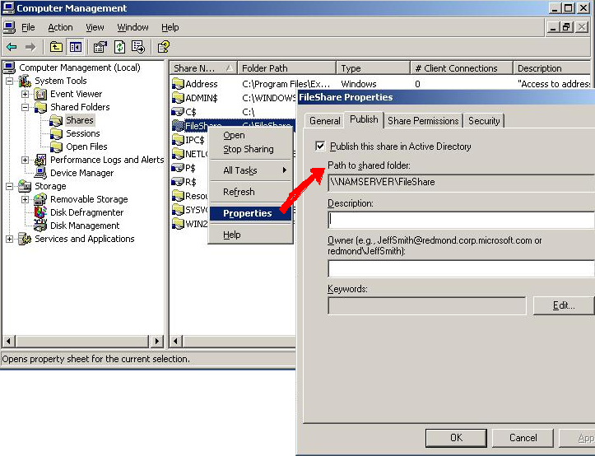
Published Share Folders
Like users, computers and printers, files and folders may be published to the Active Directory AD.
AD provides a way to locate published files and folders and secures permissions on the resources
Clients can search Active Directory for published shared folders. Clients do not need to know the name of the server to connect to a shared folder
Notes:
24

Slide 25
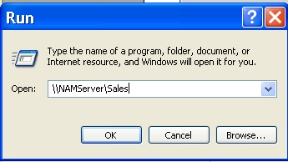
Accessing Shared Folders
Use the Run menu option with the UNC path (Universal Naming Convention):
UNC Format: \\Servername\share_name
\\FileServer1\Public or \\172.16.9.1\Public
Note:
Only non-hidden shares are shown
Hidden shares can be accessed by the UNC path, for example, \\server_name\hidden_share_name$
Notes:
25
In the lab, use \\WinSvr2012R2 or \\172.16.9.1

Slide 26
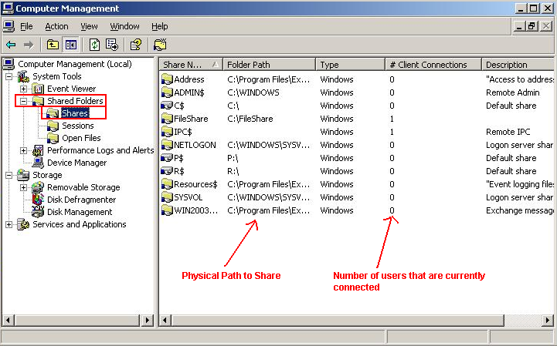
Administering Shares using Computer Management Tool
Use Computer Management tool
Click on Shared Folders ➔ Shares to view the list of shares on local machine.
Session item:
View which users are using the shared files.
Open Files item
View which shared files are being accessed at current time.
Notes:
26

Slide 27
Managing Printing (optional)
Besides managing shared folders , system administrator’s job also include managing printing devices and print configuration
Notes:
27

Slide 28
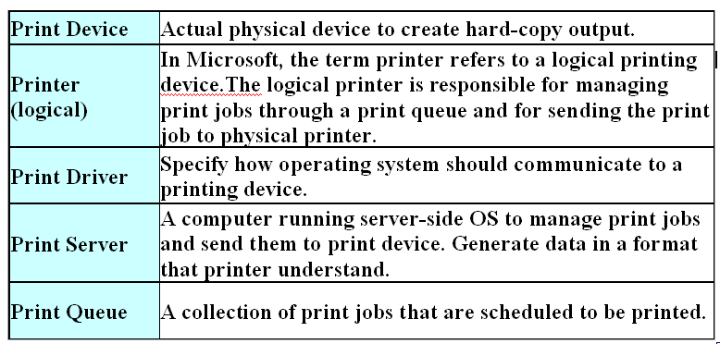
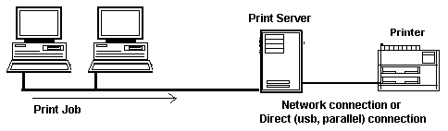
Understanding Print Terminology
Print device:.
):
Notes:
28

Slide 29
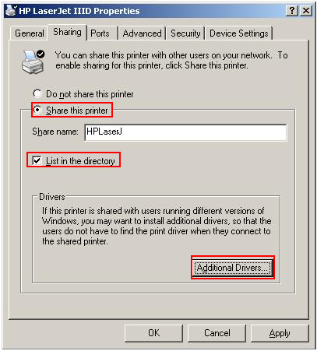
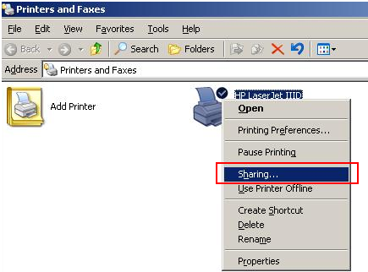
Sharing a Printer
Go to Control Panel➔ Devices and Printers
Right click on the printer to be shared and select Printer Properties
click Sharing.
Additional drivers button allow you to configure additional drivers for clients.
List In the Directory allow the printer to be published in Active Directory to make printer easier to find.
Notes:
29

Slide 30
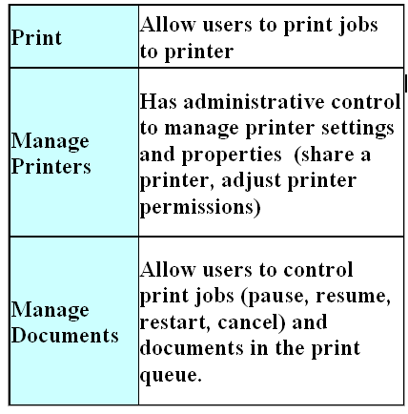
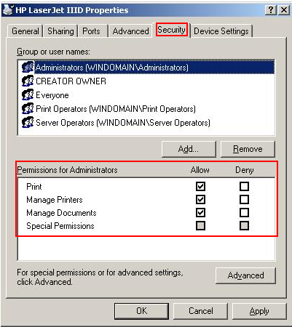
Printer Permissions
Under Security Tab
Everyone has print permissions while administrators have all print, manage printers and manage documents permissions.
Notes:
30

Slide 31
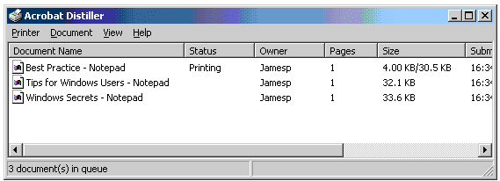
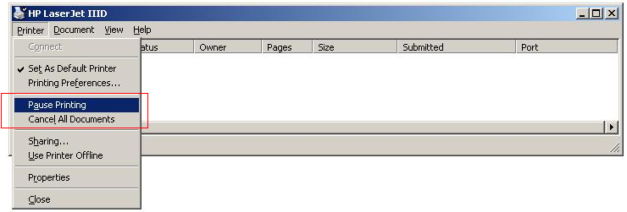
Monitoring Print Queues
Use Devices and Printers. Double click on the printer to see a list of jobs (print queue) that have been submitted to a printer.
Can click a specific document within print queue using using the Document menu, pause, resume, restart and cancel a print job.
Pause or cancel all printing jobs from the Printer Menu.
Notes:
31

Slide 32
Summary
Permissions are specified in the object’s Access Control List and are used to manage access to different resources.
NTFS Permissions
Affect to both local and remote users.
Share Permissions
Affect only to remote users; not local users.
When accessing a file locally, only NTFS permissions apply.
When combining share and NTFS permissions always choose the MOST restrictive combination.
Notes:
32

